Slide 1
Irrigation Recommendation System

Slide 2
Executive summary
irrigation recommendation system created used real time soil moisture content data, humidity, temperature, and crop metadata to generate precise watering recommendation. By automating data preprocessing and machine learning modeling. The target is to use water efficiently. Recommendations are delivered via an intuitive dashboard enabling farmers to make data driven decisions that reduces costs,, boost crop health and efficiency use of water resources

Slide 3
Project Overview: Problem Identification
Farmers in many agricultural areas today face a challenge in balancing limited water supplies against the increase need to maximize crop yield. In non demand based irrigation schedules, farmers either follow fixed irrigation practise or verify soil moisture with their hands. Both this practices leads to over irrigating water from limited water supplies, these increase pumping and power costs, nutrient leaching or under irrigating crops which put stress on crops and reduce harvests. This impacts ability to effectively deliver crops. In the absence of successfully adopting a data based approach, the decision to irrigate is based on experience or guesswork and not precise. Our problem then, is to replace uncertainty with an intelligent system that can recommend farmers to irrigate or not based on environmental conditions including moisture content,temperature,humidity,crop type and their seedling stage.this will enhance productivity and water supplies are maintained.

Slide 4
Data Exploration
Dataset Overview:
This dataset contains 16,411 records of crop related data, focusing on key environmental conditions and their effect on crop growth stage the dataset includes information such as soil type, seedling stage, moisture index(MOI), temperature and humidity. Each row represents a unique crop sample with its corresponding factors.
Data source:https://www.kaggle.com/datasets/chaitanyagopidesi/smart-agriculture-dataset

Slide 5
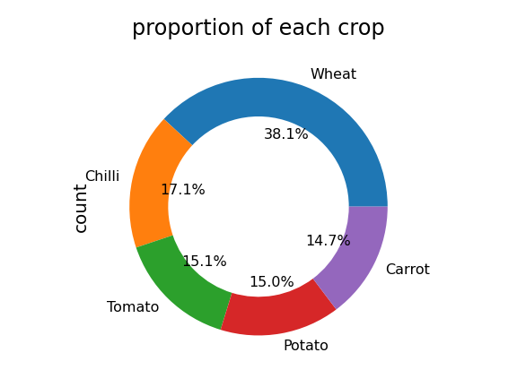
Crops we worked on

Slide 6
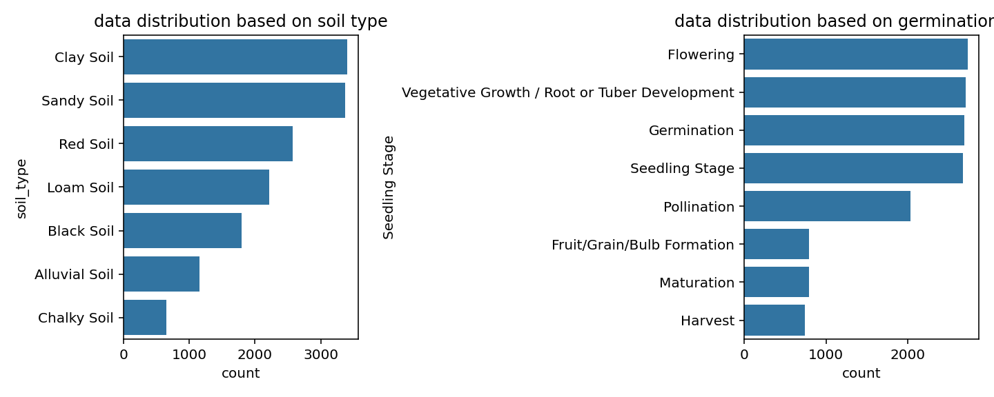
Soil type and Seedling Stage

Slide 7
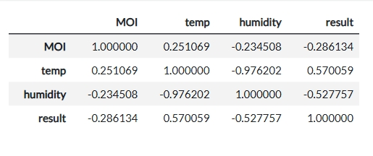
Correlation on environmental conditions
The result column is an indicator of whether a farmer has to irrigate or not
And as displayed in the table is highly correlated with temperature compared to other environmental conditions, this means that change in temperature influence the result than other considered factors

